Slide 1

Learning Companion

Slide 2
Team Details
Branch/Section: IT-A
Team Number: 2
Domain Bucket/Name: Artificial Intelligence
Team Members: P Naga Soundarya - 21BD1A1242
S Dhanunjaya - 21BD1A1255
Ch Chakradhar - 21BD1A1216
Sai Charith reddy- 21BD1A1211

Slide 3
Introduction
The AI-Powered Educational Assistant is designed to fundamentally transform how individuals engage with learning content by introducing intelligence, adaptability, and active involvement into the educational experience. It moves away from passive information consumption towards highly interactive, customized learning journeys.

Slide 4
Key Features
Pdf Reader
Youtube Transcriptor
Path Planner
Code converter & optimiser
ChatBot

Slide 5
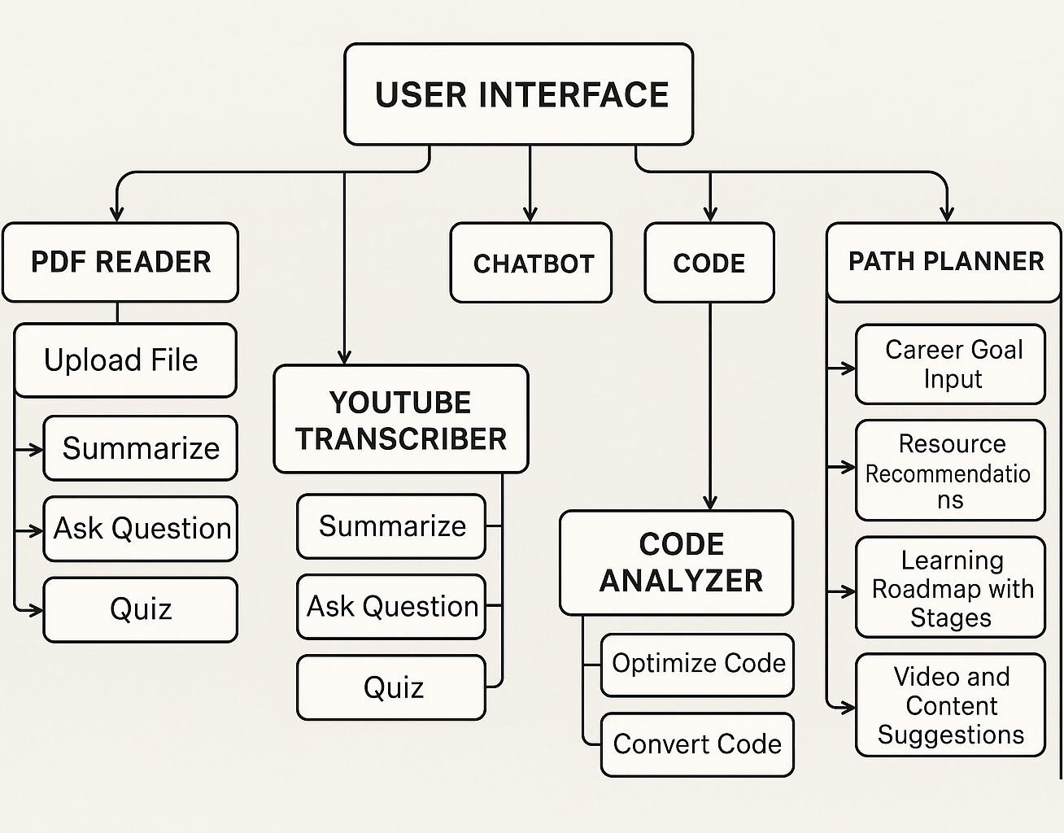

Architecture & WorkFlow

Slide 6
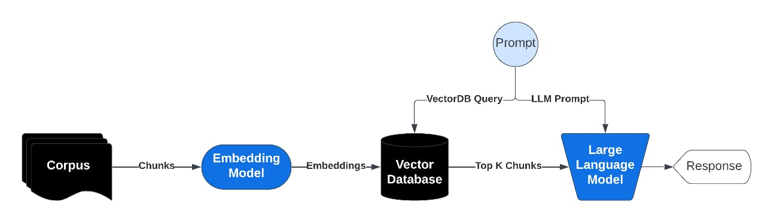
Retrieval-Augmented Generation (RAG)

Slide 7
What is an Embedding Model?
Embedding model converts text into numbers (vectors) that capture meaning.
Example:
Why use it?
Computers understand numbers, not text.
Embeddings capture semantic similarity: similar meanings → close vectors.
"Meditation reduces stress" → [0.25, 0.1, 0.4, ...] (a vector of numbers)
"Meditation improves focus" → [0.26, 0.12, 0.38, ...] (similar vector)

Slide 8
What is Vector Database & FAISS?
After converting text chunks into vectors, we need to store & search them efficiently.
Vector Database: Stores vectors linked to original text chunks
key=vector, value=text chunk
FAISS: A library by Facebook to quickly find nearest vectors (similar meaning) in large datasets.
Example:
Query vector: [0.26, 0.11, 0.39, ...]
FAISS finds closest vector: [0.25, 0.1, 0.4, ...] → returns "Meditation reduces stress".
Stored vectors:
[0.25, 0.1, 0.4, ...] → "Meditation reduces stress”
[0.5, 0.7, 0.2, ...] → "Benefits of exercise"

Slide 9
How Does Query Find the Best Matching Chunk?
User types a question: "How does meditation help?"
Convert this question into a query vector using the embedding model.
Search in the vector DB (using FAISS) for the closest vector(s).
Retrieve the corresponding text chunk(s) — e.g., "Meditation reduces stress"
Pass this chunk + question to the LLM to generate a precise answer.

Slide 10
Why Use an LLM if FAISS Finds Similar Data?
FAISS: Fast Similarity Search
Finds relevant document chunks quickly
Matches user query with stored embeddings
LLM: Language Understanding & Generation
Reads the retrieved chunks
Understands context and user intent
Generates clear, natural, and context-aware answers
Summarizes, explains, or reasons beyond plain text
Why Both?
FAISS locates info
LLM explains & summarizes it
Example:
FAISS Result: "Meditation reduces stress."
LLM Response: "Meditation helps reduce stress by calming your mind and lowering cortisol levels."

Slide 11
Proposed System
Context-Rich and Factual Outputs
Supports Long Document Reading
Less Hallucination, More Reasoning i.e grounded in actual content
Continuously Updatable – Can fetch new data from updated sources without retraining the model.

Slide 12
Technologies Used
Frontend:
React.js
Bootstrap
Programming Languages:
Python
Backend:
Flask – Web framework for API endpoints
Flask-CORS – Handling Cross-Origin Resource Sharing
dotenv – Environment variable management
FAISS – For semantic search (similarity search over embeddings)
SentenceTransformers – Text embedding (MiniLM model)
Google Generative AI (Gemini) – Language generation
YouTubeTranscriptAPI – Extracting video transcripts
PyMuPDF (fitz) – PDF text extraction

Slide 13
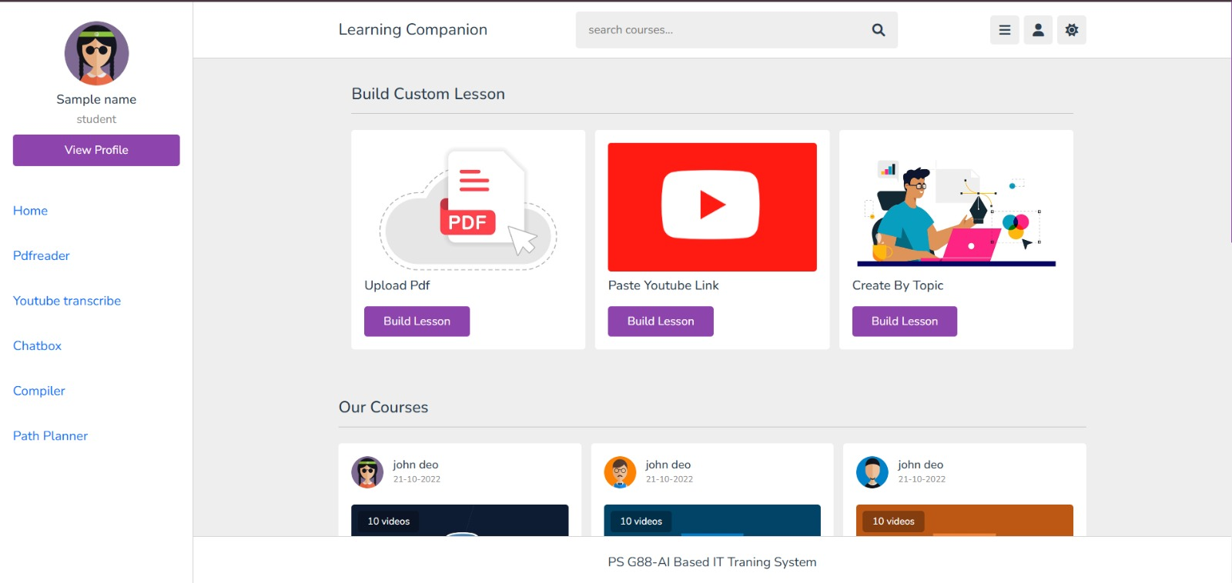
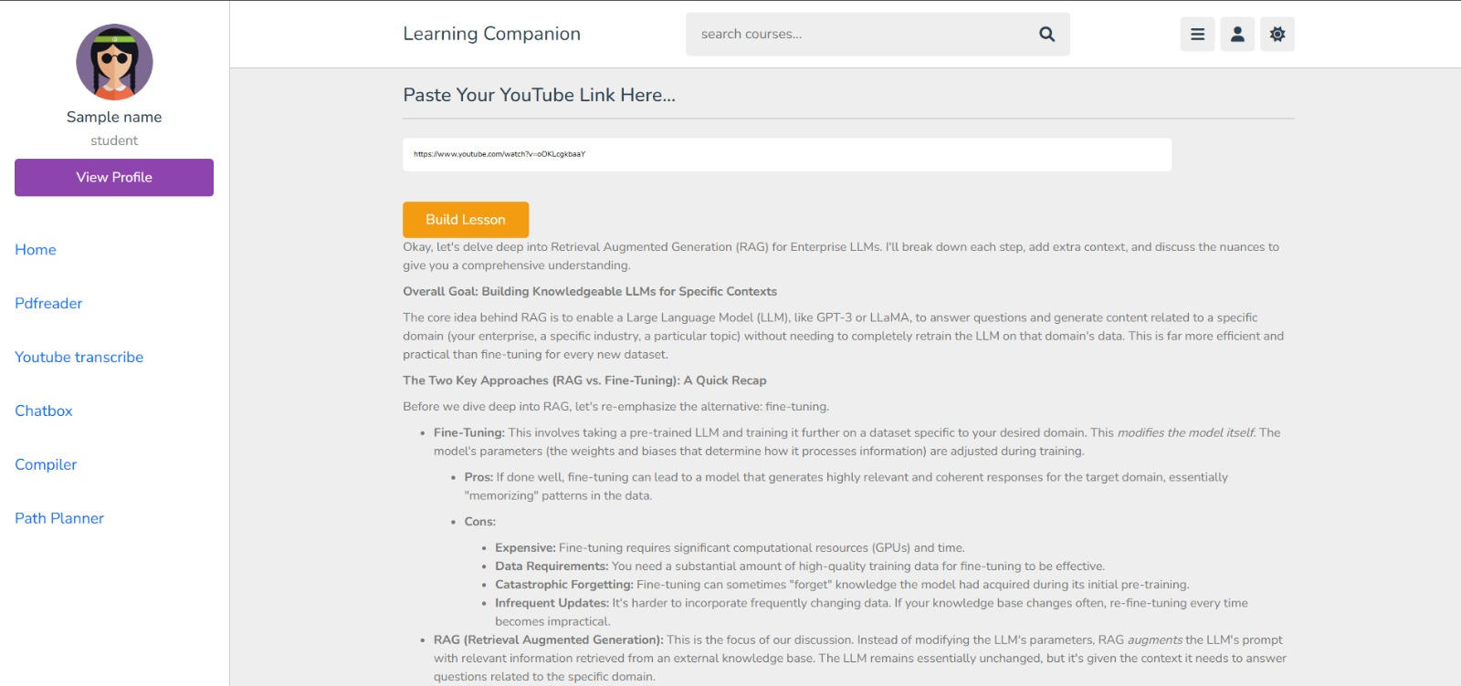
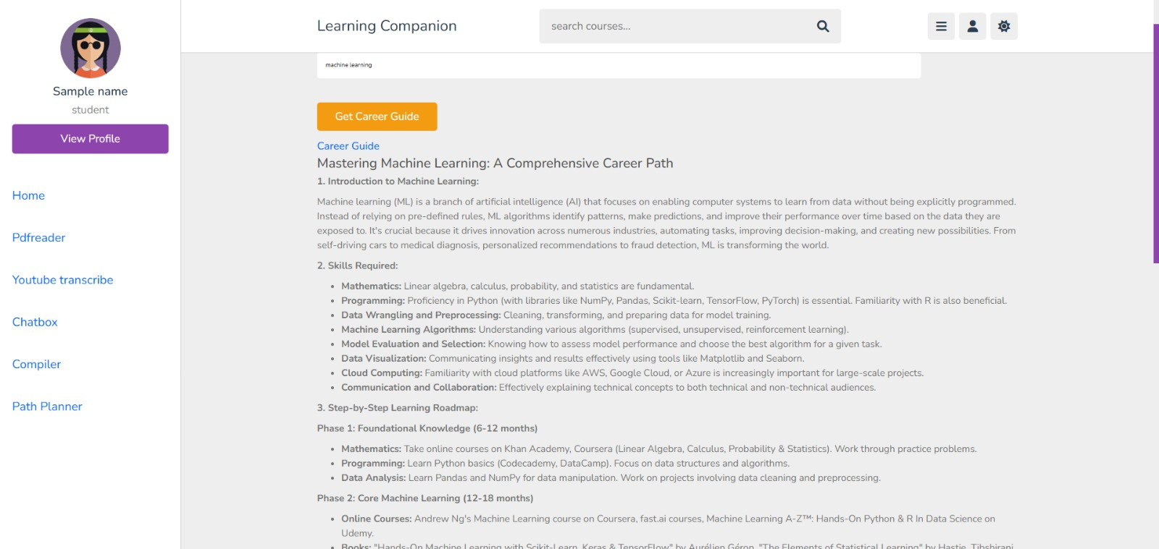
Implementation

Slide 14
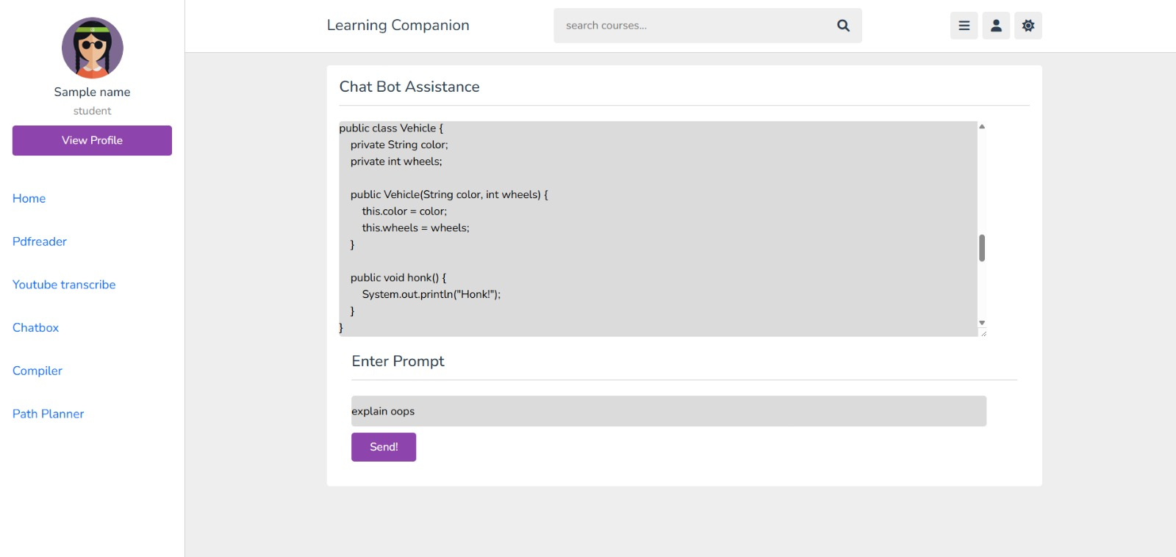

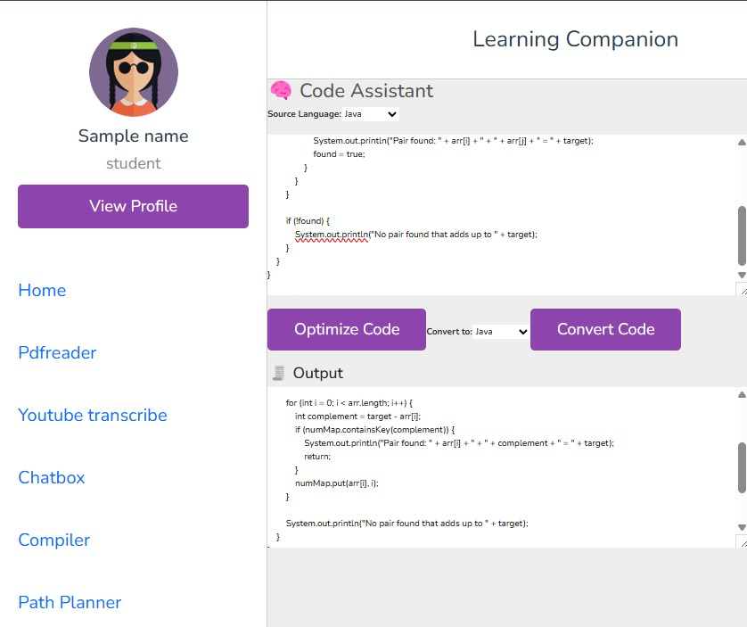
Implementation

Slide 15
Future Enhancements
Limitations
Voice-Based Learning Interface
MultiDocument support
Multilingual Support
Gamification Elements
High GPU Dependency
Internet Dependency
Scalability Challenges

Slide 16
THANK YOU

